Slide 1






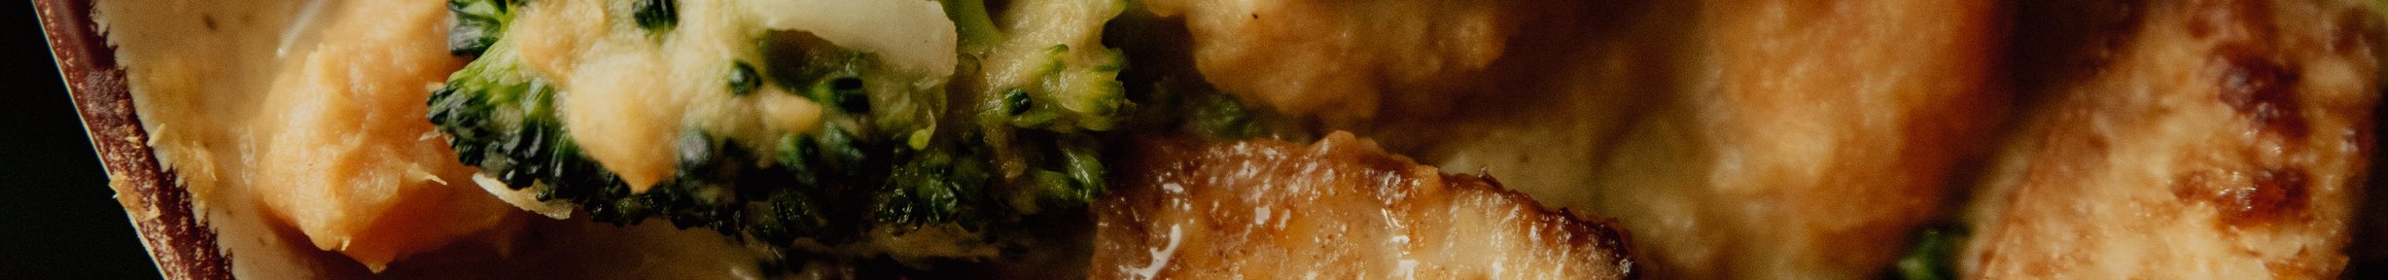
GROUP 16 Presents
Restaurant
Management
DMDD P5

Slide 2


Our Team Members
Chiranjit Banerjee
Kunal Tibe
Prasad Gavas
Sneha Yenduri
Shraddha Bhandarkar

Slide 3

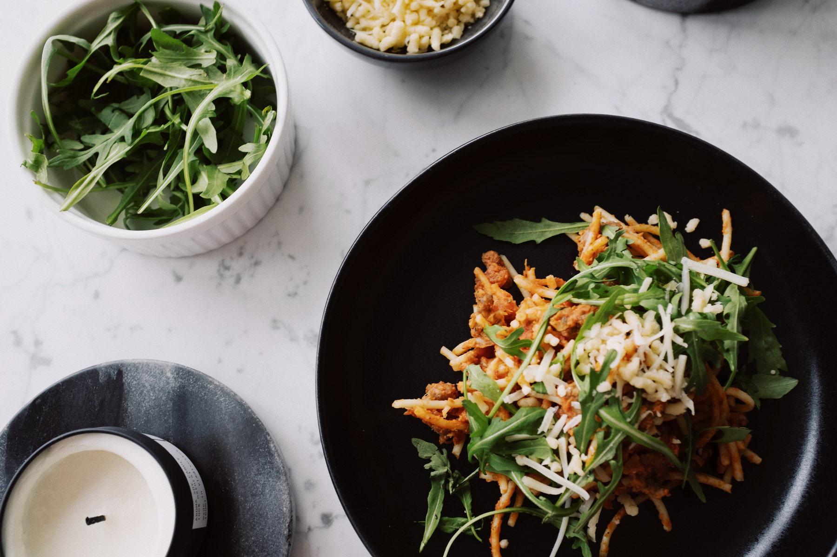
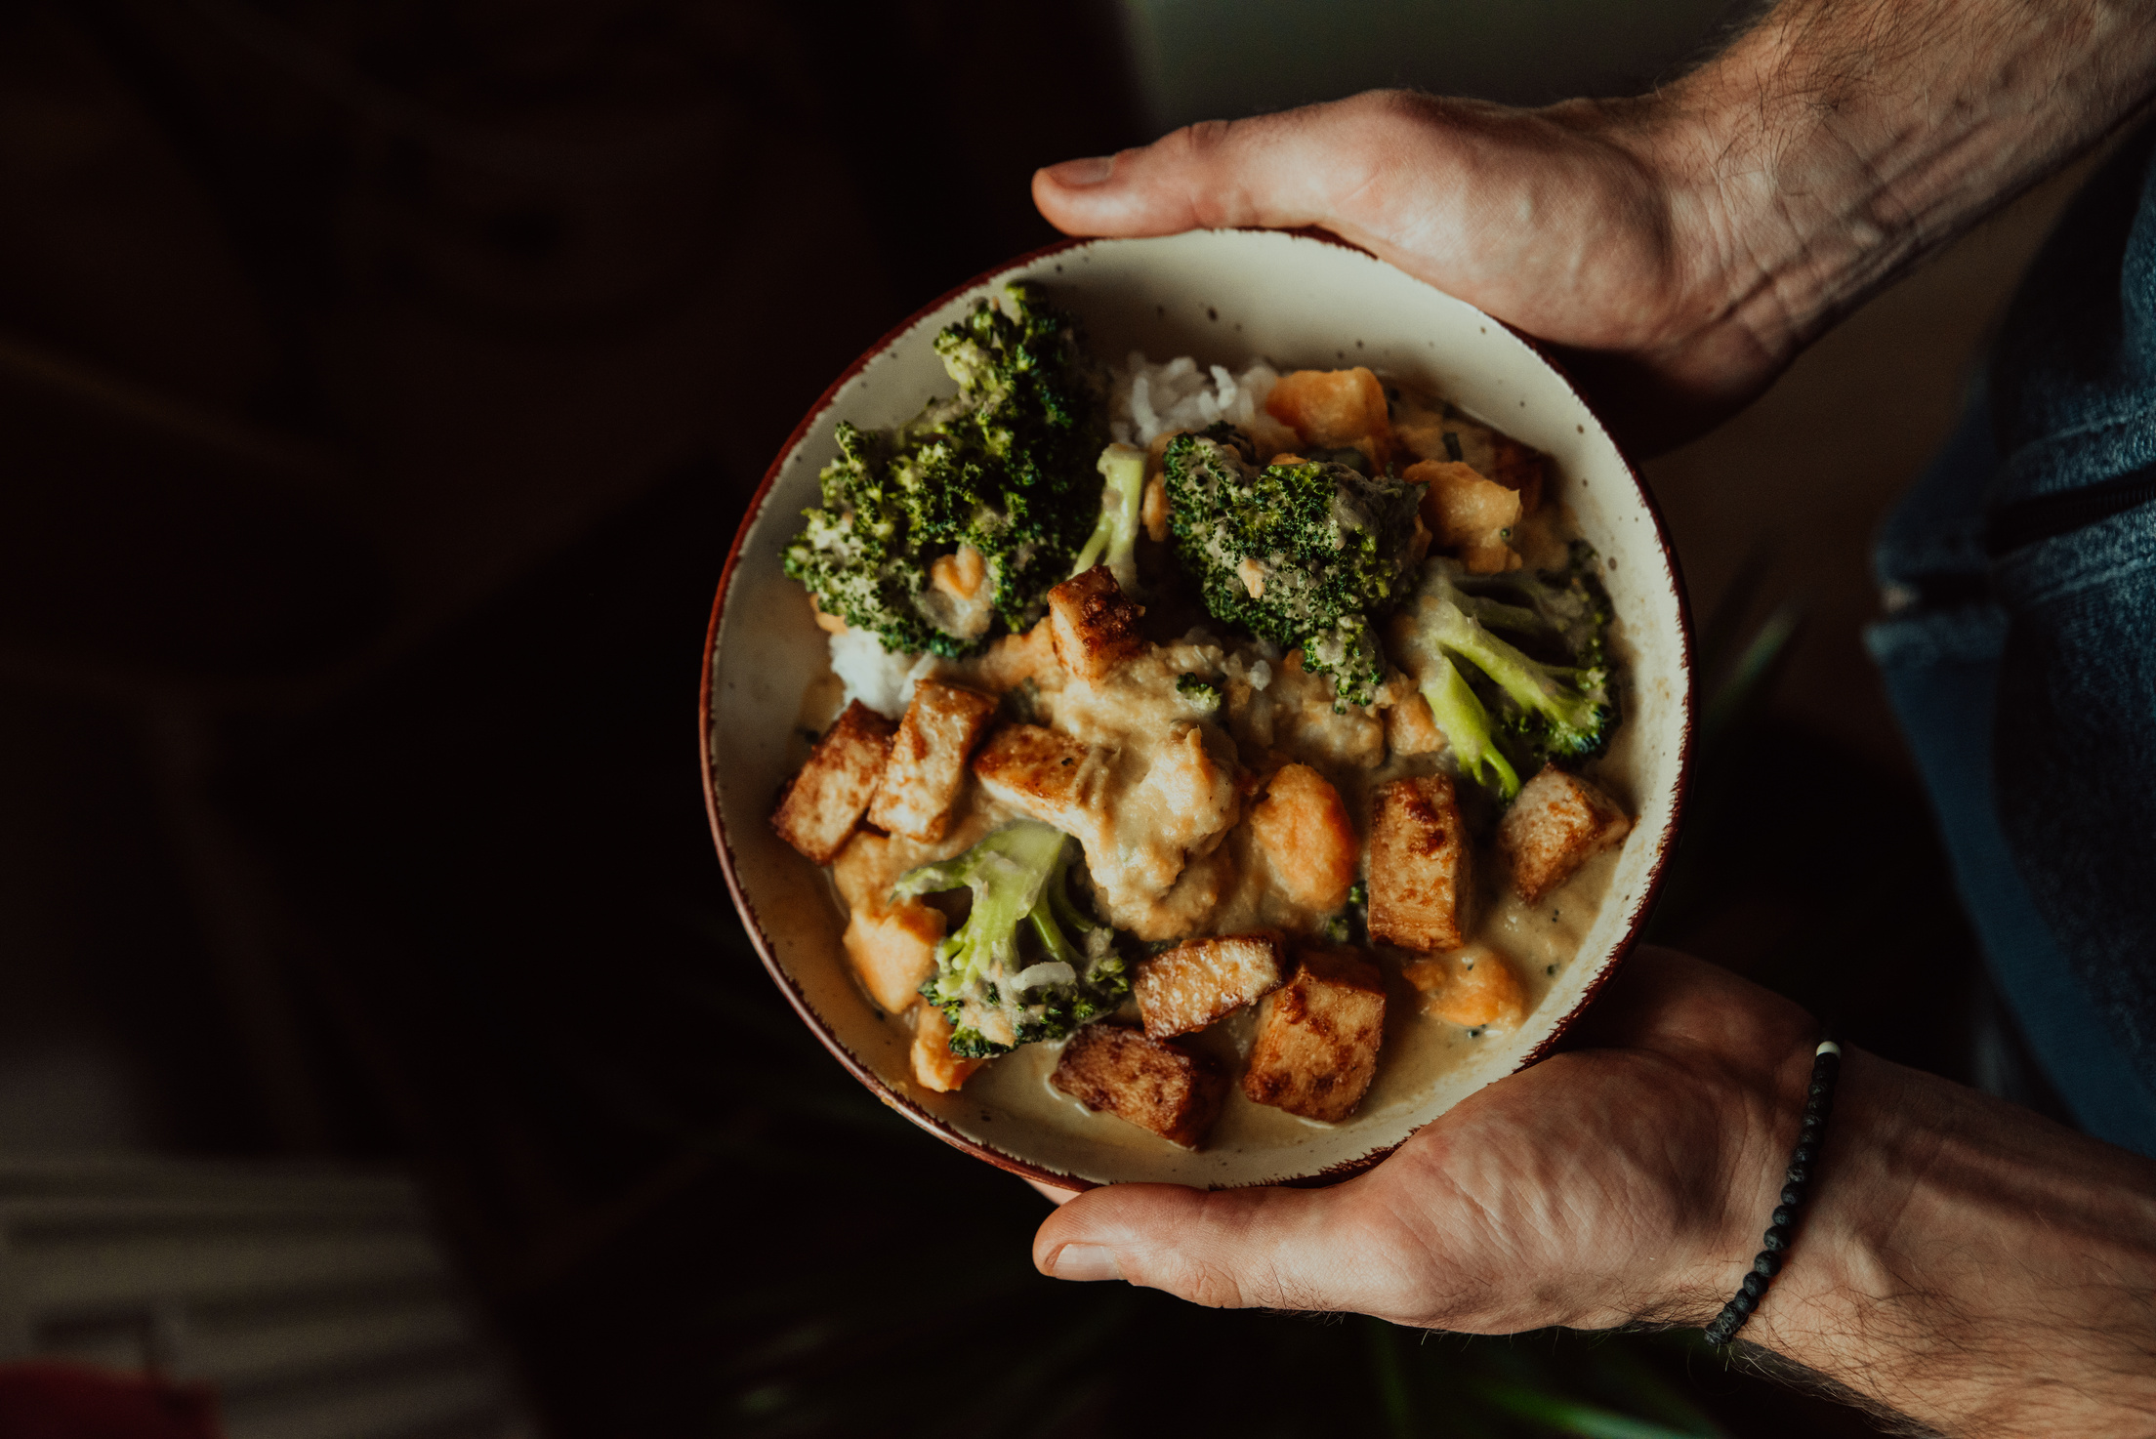
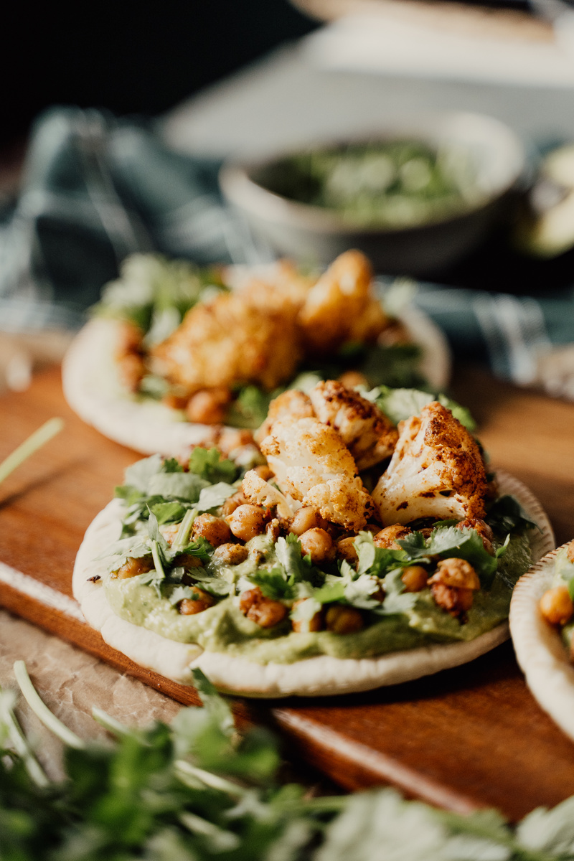

Problem Statement
It involves complex tasks to manage a restaurant, right from order processing and inventory
management to customer service and performance analysis. Manual processes often face problems like Getting errors, increased costs, and limited insight. We are faced with the challenge of improving restaurant operations through a restaurant management system based on a robust database management system (DBMS) and data visualization tools.

Slide 4

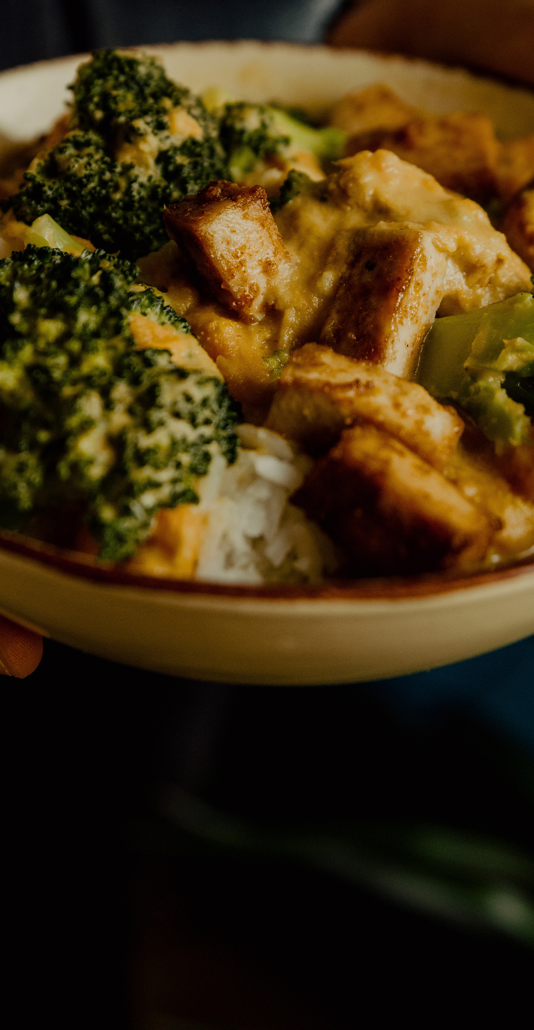

Implement an Integrated Restaurant Management System to automate order processing, table management, and inventory tracking, reducing errors and improving efficiency.
Utilize database management systems to automate order processing, table management, inventory tracking, and billing, resulting in reduced errors and improved efficiency.
Create a customer-friendly interface within the Integrated Restaurant Management System for reservations, menu viewing, and feedback submission.
Generate insights into sales trends, customer preferences, and inventory levels for future analysis using the Integrated Restaurant Management System.
Purpose

Slide 5

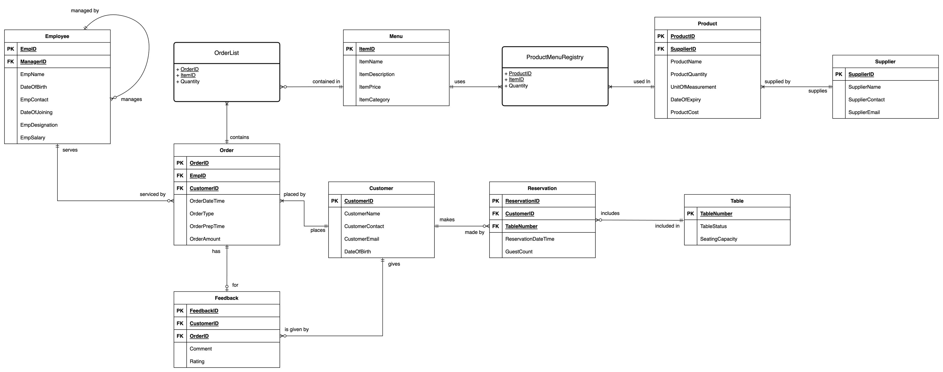
Final ERD

Slide 6

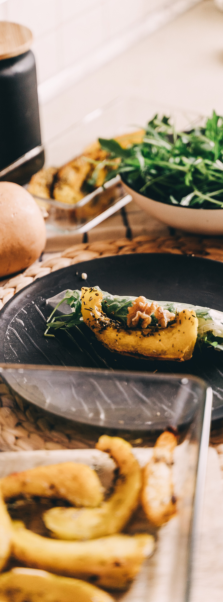
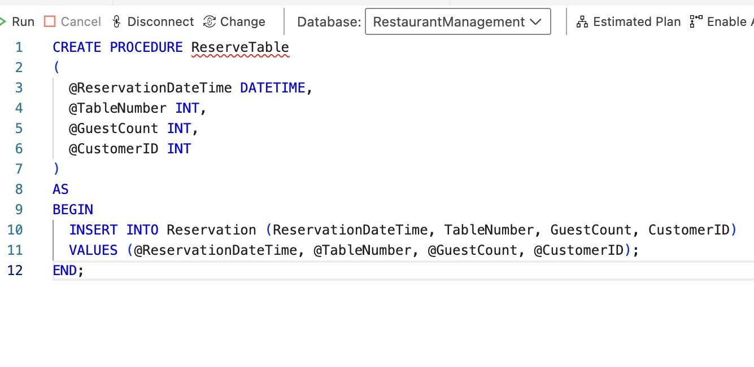
Sample Queries
PROCEDURE QUERY

Slide 7
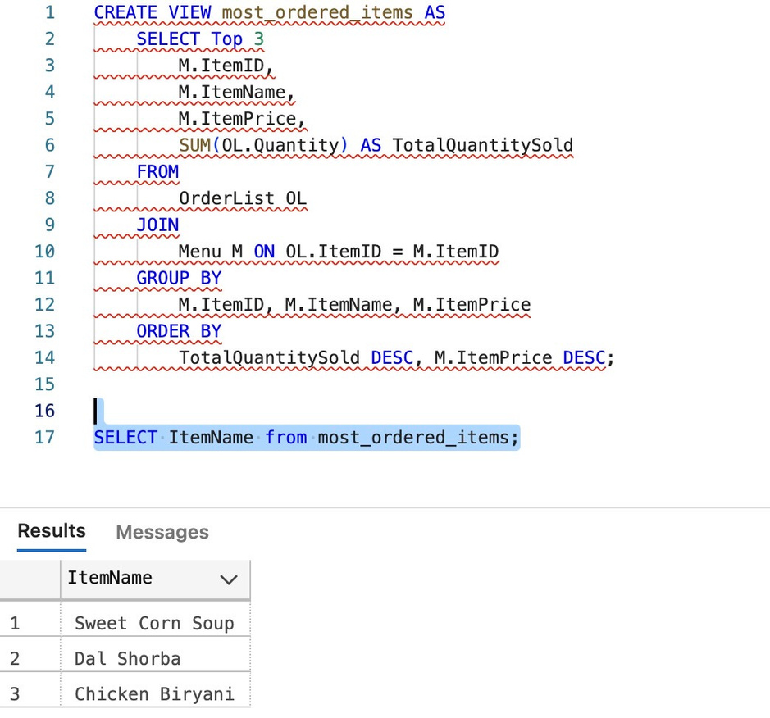
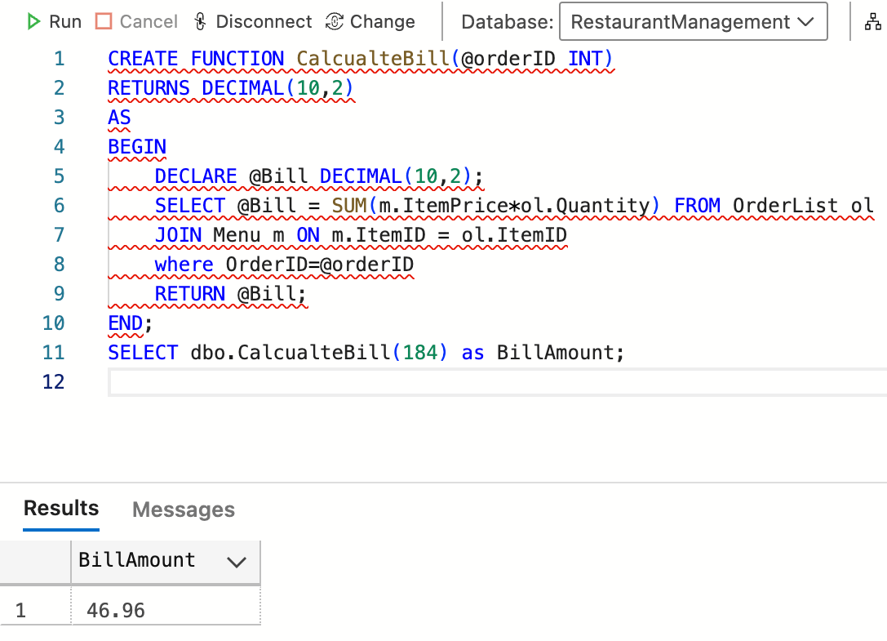

VIEW QUERY
FUNCTION QUERY

Slide 8
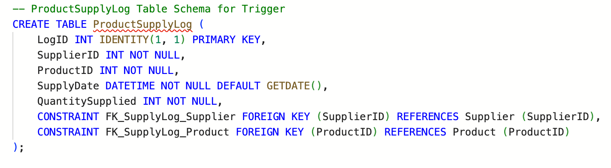
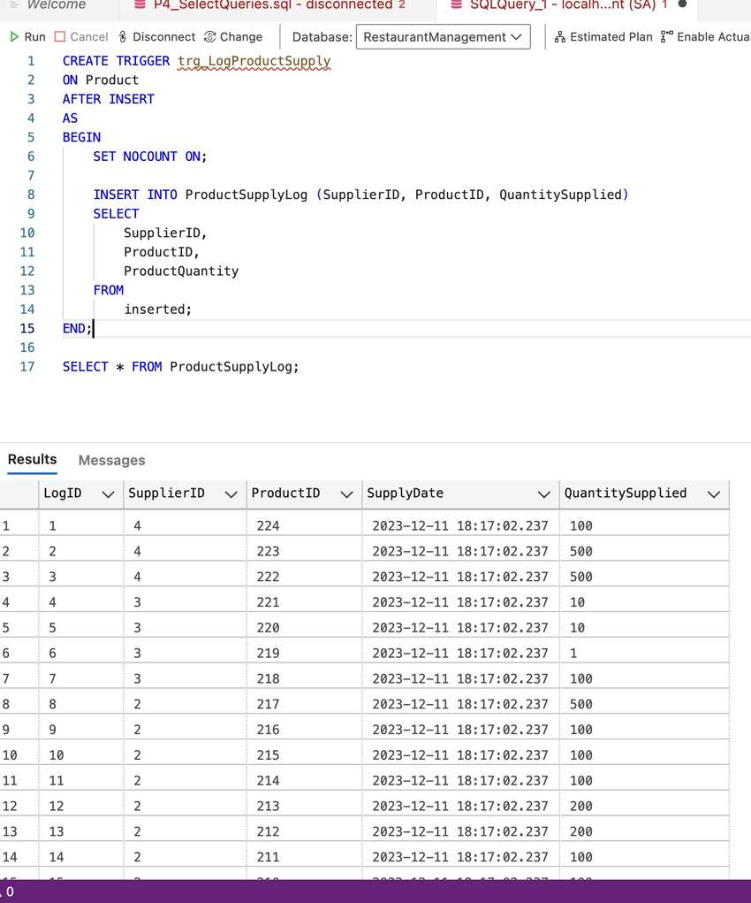
TRIGGER QUERY

Slide 9
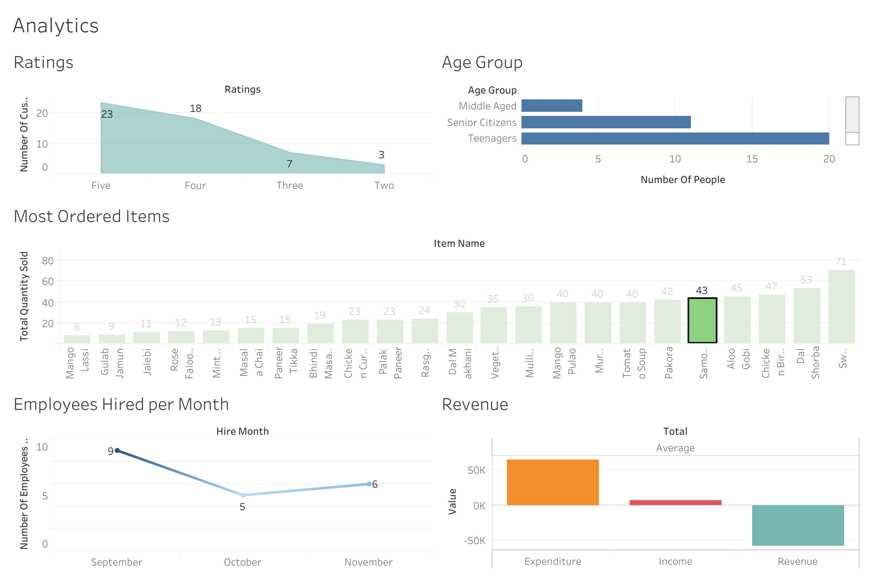
Visualization

Slide 10
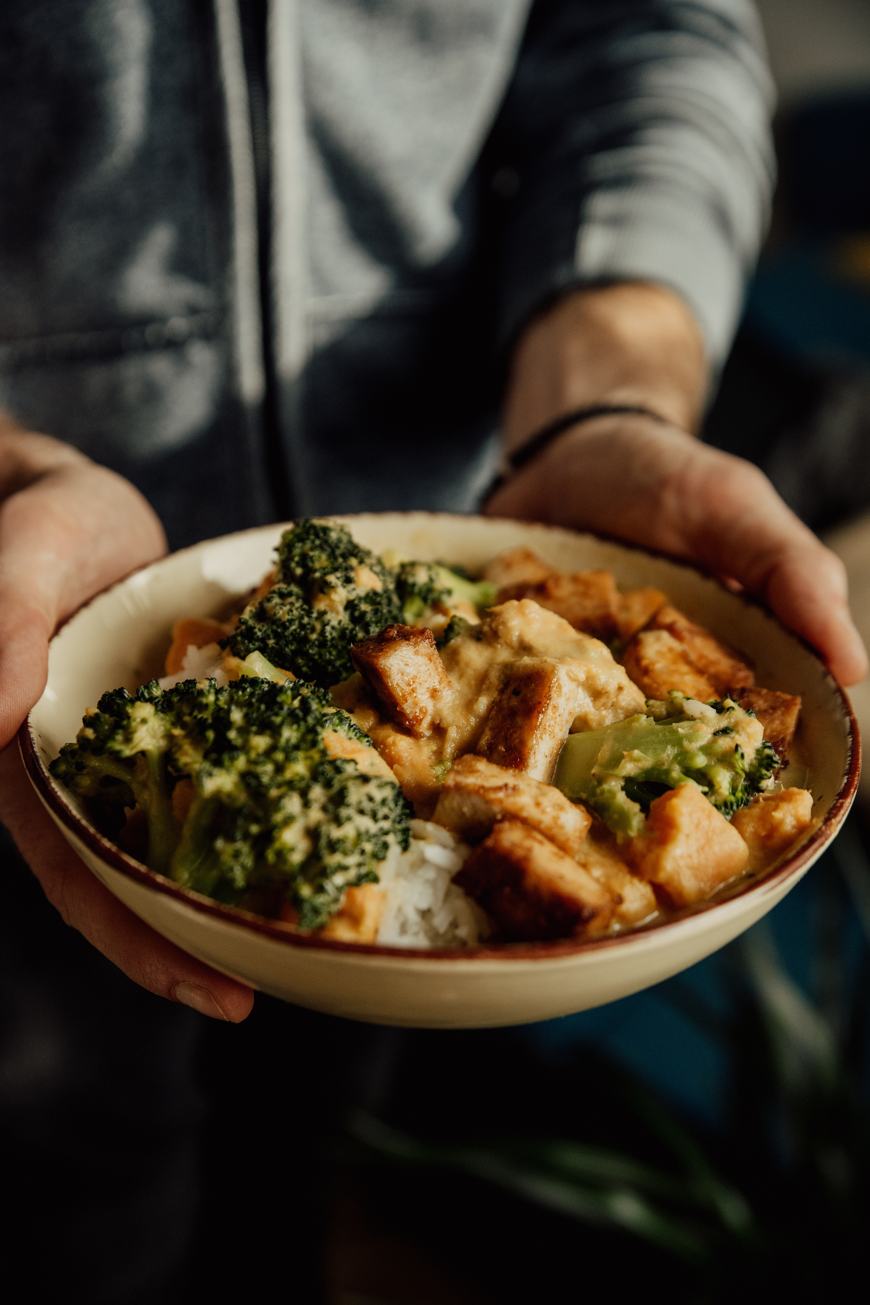


Please visit our website-
https://sites.google.com/view/dmddrestaurantmanagement/home
Thank You

